Slide 1
JANUARY 2025 EDITION
January Market Data - Health

Slide 2
JANUARY 2025 EDITION
Market Data Health

Slide 3
Health – Developments
JANUARY 2025 EDITION
£100 million investment for hospices
Mid and South Essex FT and Essex Partnership FT announce £65 million EPR contract
CQC health inequalities framework to launch in February
£200 million towards Scottish health and social care
MHRA trials new AI technologies
All 107 stroke centres in England using AI technology, says NHSE
Urgent home treatment alleviating winter pressures
Norfolk and Waveney ICB awards £250k contract for social prescribing digital platform
Digital system for managing cancer data in Wales takes important step forward
Work to begin on hospital with net zero energy system

Slide 4
Health Market landscape – notices and awards
JANUARY 2025 EDITION
Comparing contracting
activity Jan 2023 – Dec 2023 to Jan 2024 to Dec 2024 below).
Trend from prior months continues:
2023/24 – contract notices up 8.1%… awards are up 1.7%
Buyers in period 2023/24 are down 5.4% and suppliers up 14.9%
Signs of a more competitive market, potentially more buyer collaboration and framework business
Notes:
Health Market Landscape for Notices & Awards.

Slide 5
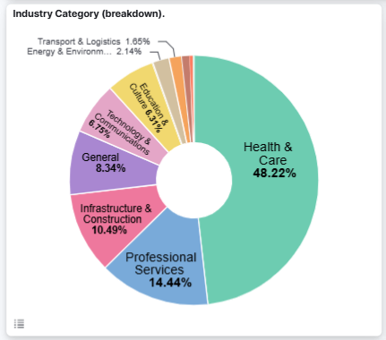
What’s being bought in Health?
JANUARY 2025 EDITION
Health & Care is the most popular by volume and value
Professional Services, Infrastructure & Construction, Technology are also high by total value (over £39bn each)
Notes:
This chart shows Health opportunities for Jan 2024 – Dec 2024.

Slide 6
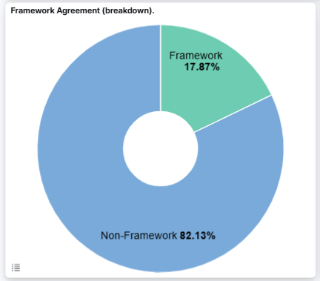
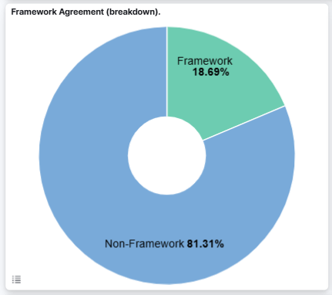
Health Framework Agreements versus Non-Framework Agreements
JANUARY 2025 EDITION
Growth in use of frameworks continues
Significant increase in Jan 24 - Dec 24 (0.82% points) versus prior period
Critical for buyers and suppliers
Potential for trend to continue – efficiency, savings
Jan 23 – Dec 23
Jan 24 – Dec 24
Notes:
This chart shows Health framework v non framework opportunities for Jan – Dec 2023 versus Jan – Dec 2024.

Slide 7
Health Framework Agreements versus Non-Framework Agreements
JANUARY 2025 EDITION
Analysis of framework awards shows the high relative value of frameworks
18.69% of notice volume, but 59.6% of award value
33.8% of suppliers have access to 59.6% of the total value of contract awards published in Jan 24 - Dec 24…gap is growing
Frameworks tend to be for larger, longer and more complex requirements (but not always)
Essential for suppliers to track and engage with frameworks
But a large volume of notices still exist outside of this approach
Notes:
This chart shows Health framework v non framework opportunities for Jan 2024 – Dec 2024.

Slide 8
Health Top 5 Frameworks Published Recently
JANUARY 2025 EDITION
HealthTrust Europe LLP acting on behalf of Mid & South Essex NHS Foundation Trust published a framework for Total Workforce Solutions III: Strategic Workforce Services with a value of £2,000,000,000
NHS Commercial Solutions published a framework for Framework Agreement for the provision of Modular & Pre-Fabricated Buildings Solutions and Associated Services with a value of £1,000,000,000
Guy's & St Thomas' NHS Foundation Trust published a framework for LPP/2024/001 Contrast Media and Associated Injectors/Consumables with a value of £383,000,000
NHS Highland published a framework for HH108-24-HB Adult Social Care Commissioning Flexible Framework with a value of £112,000,000
NHS Supply Chain published a framework for Respiratory Solutions with a value of £111,000,000

Slide 9
Market Competitiveness – Health
JANUARY 2025 EDITION
Supplier/buyer ratio = 6.7:1
No change from last month's ratio.
Notes:
This chart shows Health market competitiveness for Jan 2021 – Dec 2024.

Slide 10
JANUARY 2025 EDITION
Market Data Cross Sector

Slide 11
Market landscape – notices and awards
JANUARY 2025 EDITION
Comparing contracting
activity Jan 2023 – Dec 2023 to Jan 2023 to Dec 2024 below).
Trend from prior months continues:
2023/24 – contract notices down 5.3%… awards are up 1.4%
Buyers in period 2023/24 down 8.6% but suppliers up 5.3%
Signs of a more competitive market, potentially more buyer collaboration and framework business
Notes:
Graph at the top is Jan 2023 to Dec 2023, graph at the bottom is Jan 2024 to Dec 2024

Slide 12
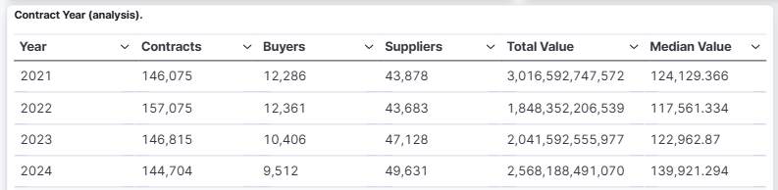
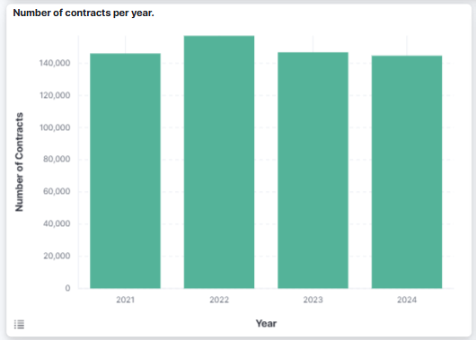
Total notice view
JANUARY 2025 EDITION
Volume of notices in 2023 6.5% less than 2022, 2024 will be less than 2023
Median value of notices significantly higher than 2021/2022; now higher than 2023
Total award value in 2023 exceeded 2022 by £193 billion, 2024 will grow again.
Overall fewer but higher value contracts (frameworks a factor again)
Sizeable, consistent market
Notes:
Jan 2021 to Dec 2024
This is the total notice view – all notices and awards
Gives a cumulative view of the value of the public sector marketplace
Demonstrates that while notice volumes and unique buyers may be reducing – the overall value of the market is up
We used to talk about a £300bn marketplace, reality is that this is now closer to £400bn
Market goes through periods of investment and efficiency drives (austerity) – but overall remains huge
Even during the austerity period, many sectors continued to rise in spend
Frameworks – a subject we’ll come to – are a factor in notices

Slide 13
Awards – transparency and insight
JANUARY 2025 EDITION
Data for Jan 2021 to Dec 2024
Awards (blue line) outstripping notices (green line) – good for transparency intel/planning/early engagement
Gap narrowed May/June but appears to have widened again
Procurement becoming more transparent – confidence/trust
Notes:
Jan 2021 to Dec 2024
Award notices are an important piece of market intelligence
Understanding what contracts have been awarded, to what value and to which suppliers is an important form of market intelligence
Also, a good indicator of transparency.
Theoretically, every published notice should have a corresponding award – but this has never been the case.
However, we are tracking a significant upshift in the volume of award notices published, with these now outstripping notices
Some of this will be due to fewer notices shifting the balance – however, overall, a higher volume of Awards can only be good for transparency and insight into future opportunities

Slide 14
JANUARY 2025 EDITION
Market Data Framework Agreements

Slide 15
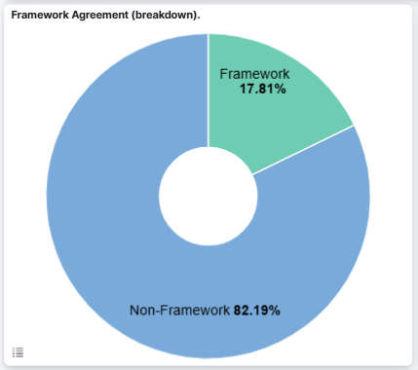
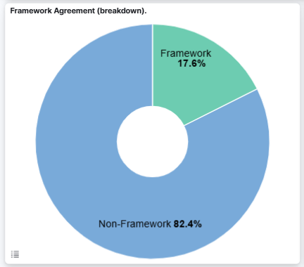
Framework Agreements versus Non-Framework Agreements
JANUARY 2025 EDITION
Growth in use of frameworks continues
Small increase in Jan 24 - Dec 24 (0.21% points) versus prior period
Critical for buyers and suppliers
Potential for trend to continue – efficiency, savings
Jan 23 – Dec 23
Jan 24 – Dec 24

Slide 16
Framework Agreements versus Non-Framework Agreements
JANUARY 2025 EDITION
Analysis of framework awards shows the high relative value of frameworks
17.6% of notice volume, but 68.3% of award value
32.7% of suppliers have access to 68.3% of the total value of contract awards published in Jan 24 - Dec 24…gap is growing
Frameworks tend to be for larger, longer and more complex requirements (but not always)
Essential for suppliers to track and engage with frameworks
But a large volume of notices still exist outside of this approach

Slide 17
Framework Notices by Buyer Sector
JANUARY 2025 EDITION
For Jan 24 to Dec 24 – Local Government published 2,994 framework notices - £335bn value
LG has 411 buying organisations using frameworks – CG, Health, Education an average of 121
Central Government 1,019 framework notices, £412bn value (significantly higher value per framework)
Health 995 framework notices, £123bn value – also high average value
Total buyers using frameworks = 2077 (not de-duped) – around 50% of the buyer market
Notes:
Jan 2024 – Dec 2024 – Framework Notices ONLY

Slide 18
Framework Agreements by Sector
JANUARY 2025 EDITION

Slide 19
Market Competitiveness
JANUARY 2025 EDITION
Jan 2023 – Dec 2023 (top)
Jan 2024 – Dec 2024 (below)
8.6% fewer buyer organisations
5.3% more supplier organisations
Supplier/buyer ratio = 5.22:1
Was 4.53:1
Established trend – market is more competitive overall (good for us)
Early Engagement and relationship building more important than ever

